Slide 1
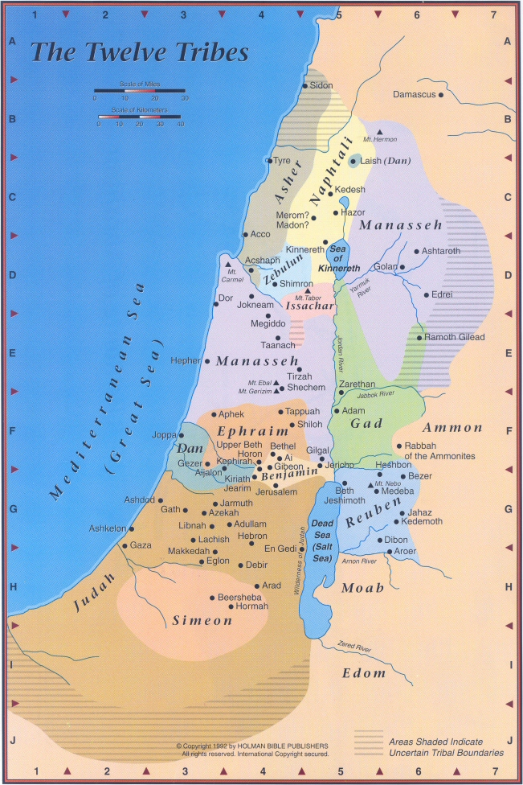

Slide 2
Galatians 6:1 Brethren, even if anyone is caught in any trespass, you who are spiritual, restore such a one in a spirit of gentleness; each one looking to yourself, so that you too will not be tempted.
The purpose is to gather information:
1. Not to prove that you are right
2. Not to frighten or intimidate anyone
3. Not to unload on someone or tell them off
4. Not to lie or distort the facts
5. Not to establish blame but to seek a resolution
You should:
Pray before going
Stay calm
Proverbs 15:1 A gentle answer turns away wrath,
But a harsh word stirs up anger.

Slide 3
Galatians 6:1 Brethren, even if anyone is caught in any trespass, you who are spiritual, restore such a one in a spirit of gentleness; each one looking to yourself, so that you too will not be tempted.
The purpose is to gather information:
1. Not to prove that you are right
2. Not to frighten or intimidate anyone
3. Not to unload on someone or tell them off
4. Not to lie or distort the facts
5. Not to establish blame but to seek a resolution
You should:
Pray before going
Stay calm (Prov. 15:1)
Keep an open mind, there are two sides to every story
Stay objective, don’t take things personally
Listen to what they say
James 1:19 But everyone must be quick to hear, slow to speak and slow to anger;

Slide 4
Galatians 6:1 Brethren, even if anyone is caught in any trespass, you who are spiritual, restore such a one in a spirit of gentleness; each one looking to yourself, so that you too will not be tempted.
The purpose is to gather information:
1. Not to prove that you are right
2. Not to frighten or intimidate anyone
3. Not to unload on someone or tell them off
4. Not to lie or distort the facts
5. Not to establish blame but to seek a resolution
You should:
Pray before going
Stay calm (Prov. 15:1)
Keep an open mind, there are two sides to every story
Stay objective, don’t take things personally
Listen to what they say (James 1:19)
Be willing to acknowledge any wrongdoing on your part
7. Be quick to forgive wrongdoing on their part (no grudges)

Slide 5
If the issue cannot be resolved:
Stay calm
2. Don’t make any threats
3. Don’t seek revenge
4. Put it in the Lord’s hands
5. Don’t harbor any MAS towards them (unconditional love)
6. Pray for them
7. Don’t talk about them or what happened to others

Slide 6
1 Corinthians 16:13
Be on the alert, stand firm in the faith, ACT LIKE MEN, be strong.
14) Let all that you do be done in LOVE.

Slide 7
Question: Why do we find an entire
chapter filled with many specific
details covering the issue of an altar
being built?
Answer: Because it illustrates principles that are vital for people to live together in harmony.

Slide 8
COMMUNICATION
Don’t Interrupt
2. Be Considerate
3. Be Mindful Of Other’s Time
4. Be Tolerant
5. Be Clear
6. Be Verbal
7. Be Physical

