Slide 1
Rom 8:28
. . . And we know, that to those [mature believers] who love the God [Jesus Christ], HE [God the Father] works all things together for [the purpose of] THE GOOD [The Plan of God X+Y+Z] to those [mature believers] who are the called / elected ones according to His pre-determined plan.

Slide 2
God’s pre-determined Plan consists of Seven Imputations which can be demonstrated by an X + Y + Z formula.

Slide 3
X THE UNBELIEVER
X + Y + Z
Y
THE BELIEVER
Z
THE MATURE BELIEVER

Slide 4
IMPUTATION
The English noun is derived from the Latin verb IMPUTARI, meaning to reckon, to attribute, to ascribe, to charge to one's account.
Imputation is used in the Bible as an act of God whereby either condemnation or blessing is ascribed, attributed, reckon- ed, given, or imposed on the human race.

Slide 5
Two CATEGORIES:
REAL IMPUTATION: The justice of God imputes under the principle of antecedence and affinity. That which is imputed is in harmony, agreement, or affinity with the target of the imputation.
JUDICIAL IMPUTATION: An imputation where there is no affinity or harmony between what is imputed and the home or target of the imputation.
In the Plan of God, there are 2 Judicial and
5 Real Imputations.

Slide 6
THE UNBELIEVER
X HL + AOS = P₁ + BD = H₁
+
Adam’s
Original
Sin
Human Life
Potential One
The
Gospel
Hope One

Slide 12
THE BELIEVER
Y J₁ + J₂ = P₂ + BD = H₂
+
Judicial
Imputation
# 1
Potential 2
Hope 2
Bible
Doctrine
Judicial
Imputation
# 2

Slide 13
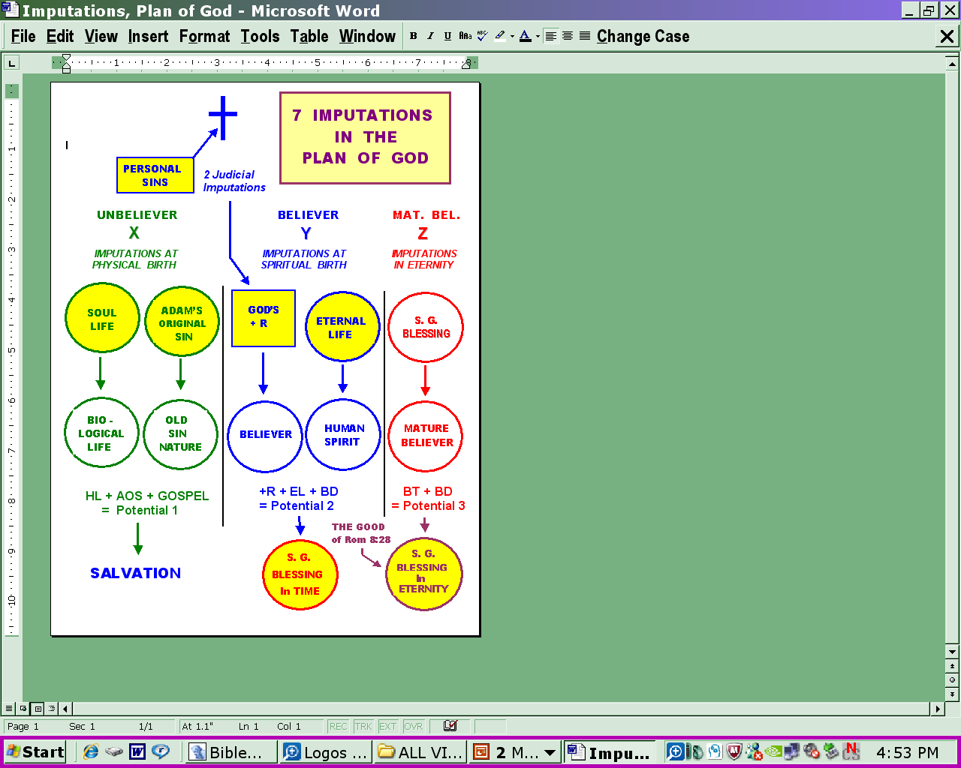
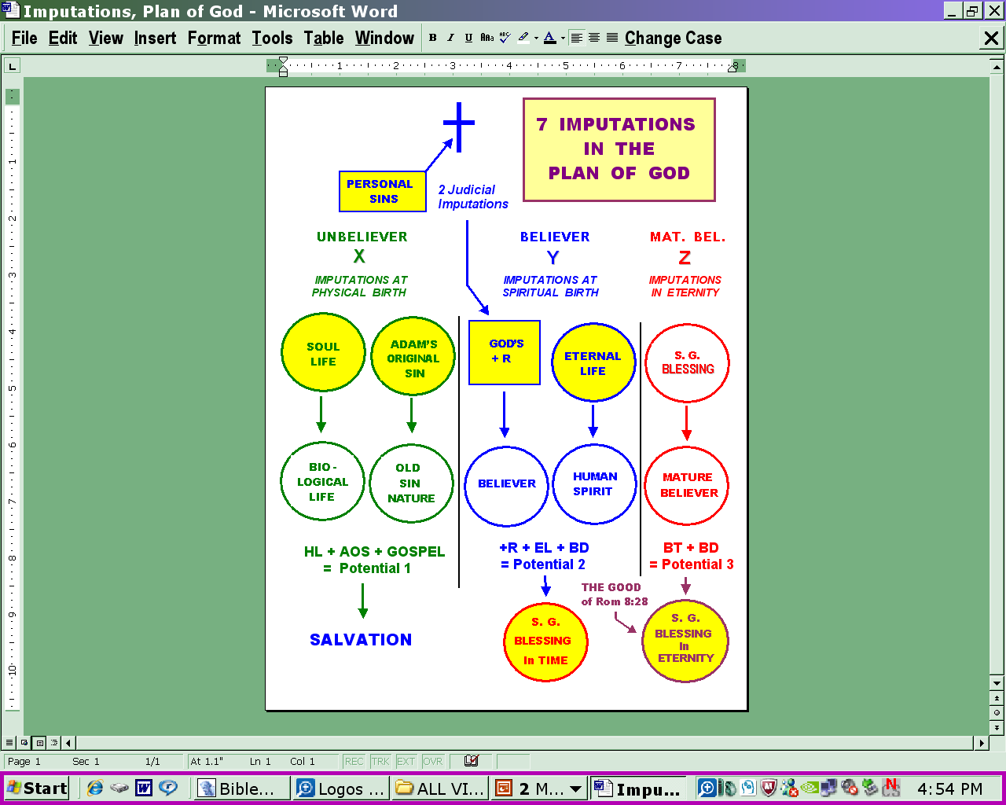
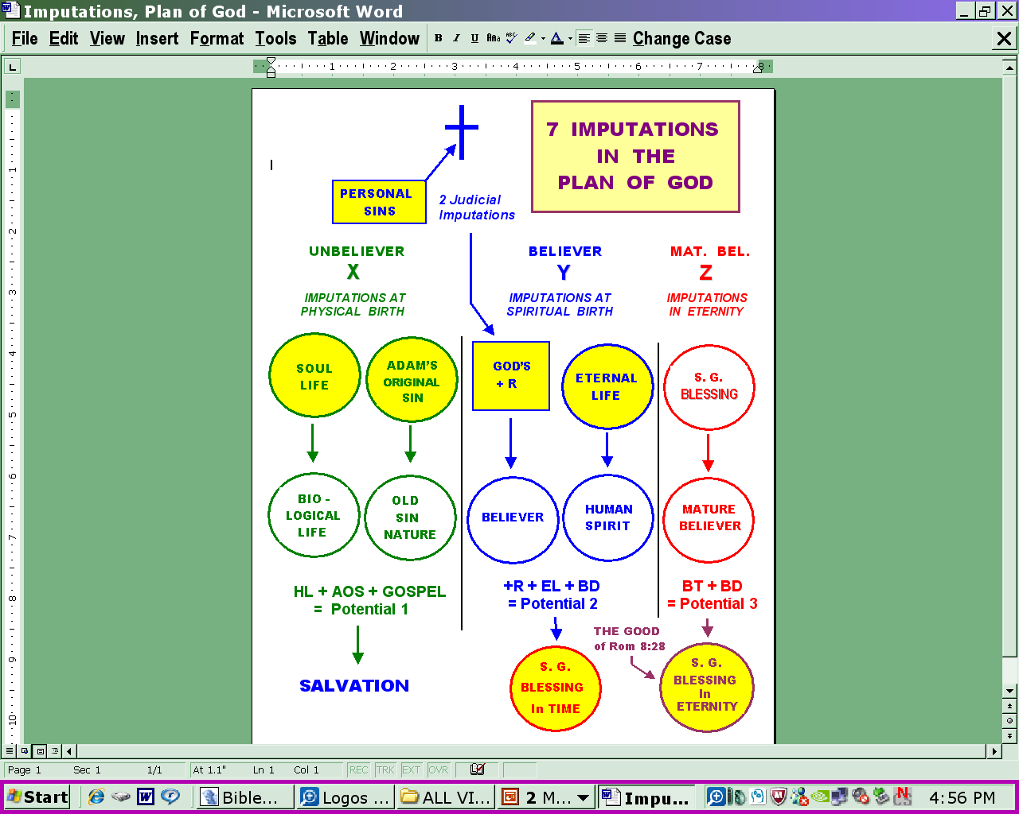
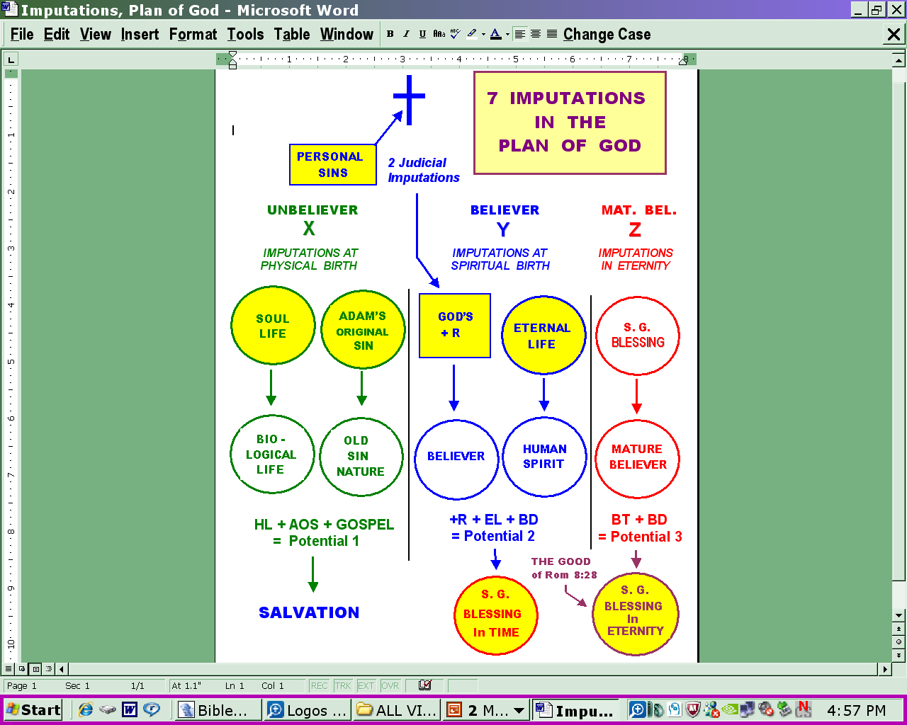
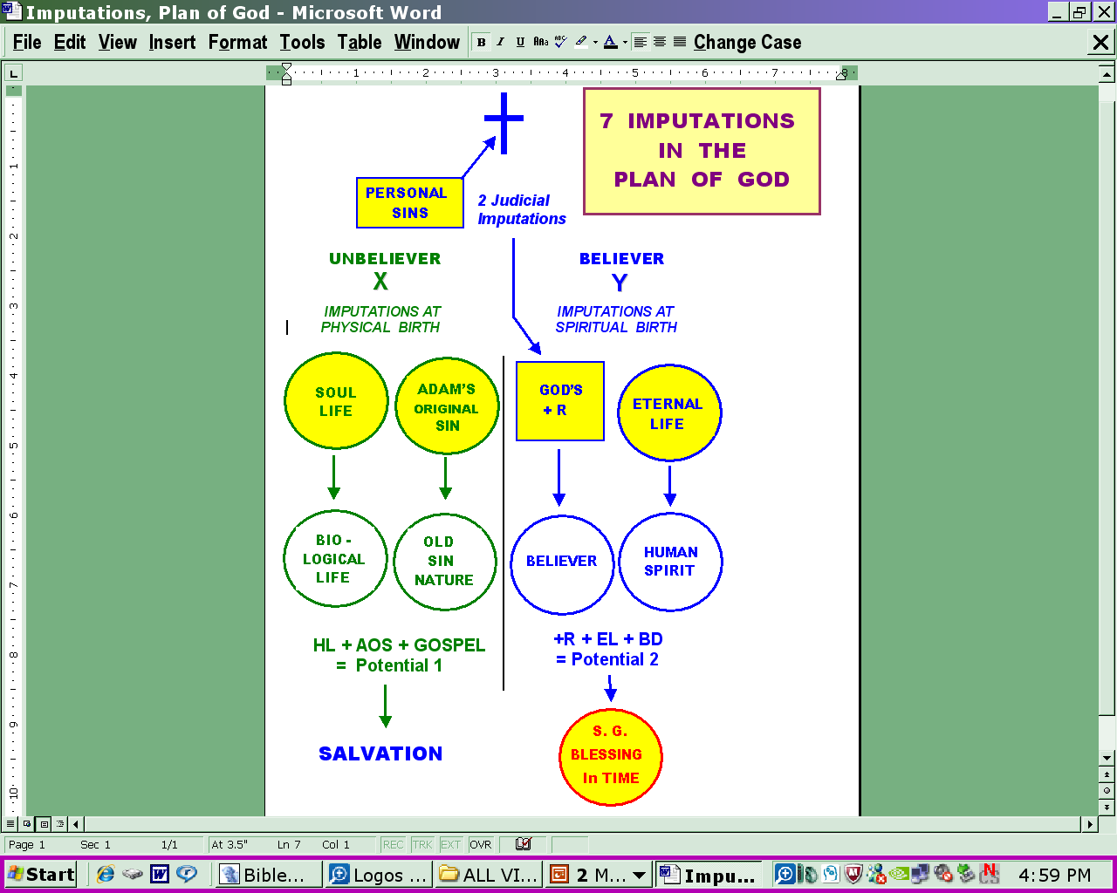

Slide 14
THE MATURE BELIEVER
Z EL + BT = P₃ + BD = H₃
+
Potential 3
Hope 3
Eternal Life
Bible Doctrine
Blessings
In Time

Slide 15
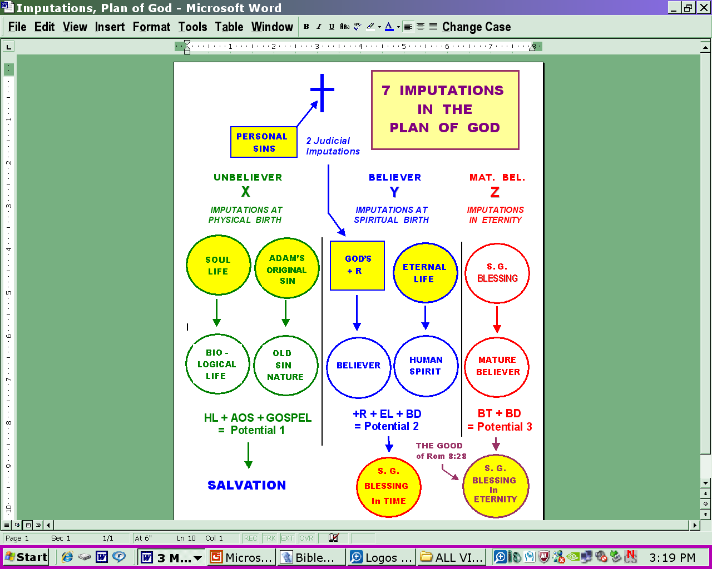

Slide 16
THE PLAN OF GOD RATIONALE
X HL + AOS = P₁ + BD = H₁
X + Y + Z
+
Y J₁ + J₂ = P₂ + BD = H₂
+
Z EL + BT = P₃ + BD = H₃
+

